Slide 1
Making this resource work for you
Prior to teaching this lesson, please refer to the ‘Unit Overview and Planning Document’.
Further guidance on planning Science Mastery lessons can be found in the detailed planning guidance document.
Refer to the ‘notes’ section on each slide for useful information, including suggested expositions, pedagogical content knowledge, suggested questions, answers and more. Consider using presenter mode so you can see this guidance throughout the lesson.
The introduction slides can be adapted to suit your teaching style and the needs of your class.
Before the lesson, adapt the fix-it slide to address any misconceptions identified in the previous lesson’s exit ticket.
Choose from the suggested activities to suit your class. The intention is not that you complete all of these, but that you select those which ones are most appropriate for your students. It may be appropriate to further adapt activities for your students.
These lessons are designed to occupy approximately 1 hour. To adapt for a shorter or longer lesson duration we advise you to adapt the activity section accordingly.
Please consider using the final slide to send feedback about this lesson or examples of PowerPoints that you have adapted to our design team. Your feedback is used to improve Science Mastery for all of our teachers and students. We appreciate all suggestions and comments.
Thank you for reading!
The Science Mastery Team

Slide 2

Writing Half Equations
Answer the questions below.
Define oxidation in terms of electrons.
Define reduction in terms of electrons.
True or false? A more reactive metal is more likely to form positive ions.
Sodium atoms (Na) are oxidised to Na⁺ ions in a reaction. Why is this an oxidation reaction?
Complete the general word equation to show the product of a reaction between a metal and oxygen. Metal + oxygen →
Oxidation is the loss of electrons
Reduction is the gain of electrons
True
This is an oxidation reaction because the sodium atom lost an electron.
Metal + oxygen → metal oxide
Notes:
Big idea: Reactions Rearrange Matter
Foundation: State the formula for a hydrogen ion
Stretch: State the formula for an oxide ion
Answers:
Foundation: H⁺
Stretch: O²⁻

Slide 3
Writing Half Equations
Do Now:
Define oxidation in terms of electrons.
Define reduction in terms of electrons.
True or false? A more reactive metal is more likely to form positive ions.
Sodium atoms (Na) are oxidised to Na⁺ ions in a reaction. Why is this an oxidation reaction?
Complete the general word equation to show the product of a reaction between a metal and oxygen. Metal + oxygen →
Drill:
State the formula for a chloride ion.
Rewrite this ionic equation so that it is correct:
H⁺_{(aq)} + Cl⁻_{(aq)} + K⁺ _{(aq)} + OH⁻_{(aq)} → K⁺_{(aq)} + Cl⁻_{(aq)} + H₂O_{(l)}
Notes:
Answers:
Do now:
1. Oxidation is the loss of electrons
2. Reduction is the gain of electrons
3.True
4. This is an oxidation reaction because the sodium atom lost an electron.
5. Metal + oxygen → metal oxide
Drill:
1. Cl⁻
2. (Removing the spectator ions): H⁺_{(aq)} + OH⁻_{(aq)} → H₂O_{(l)}

Slide 4
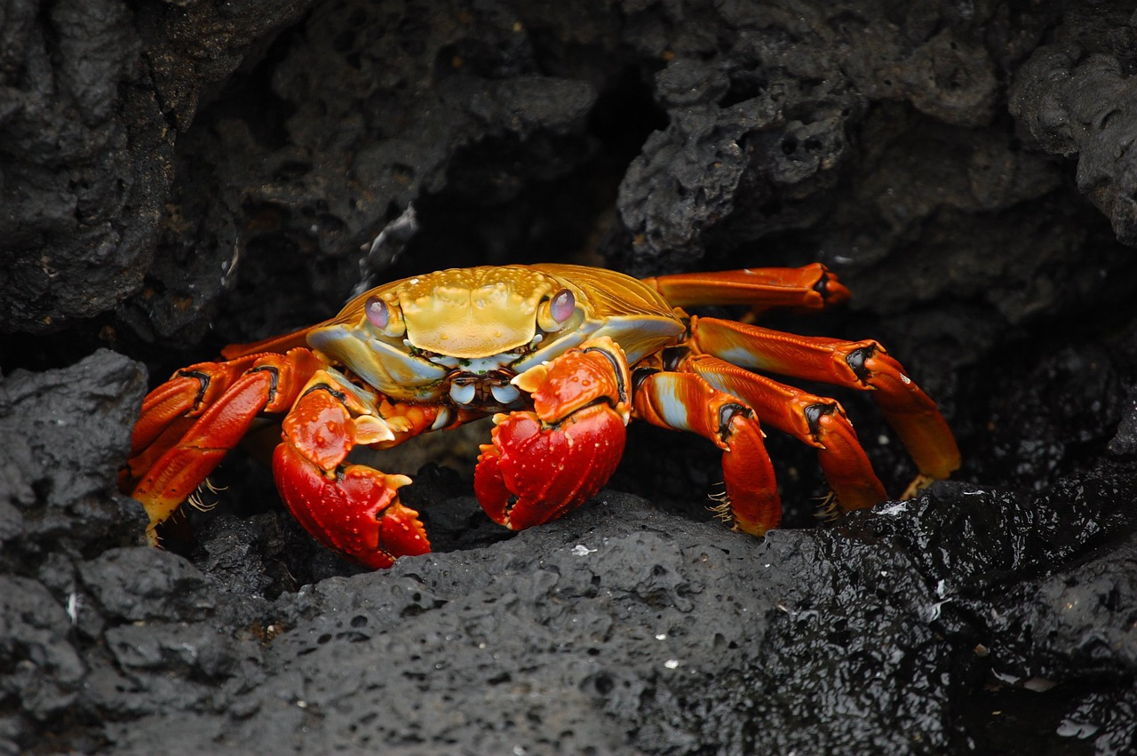
Writing Half Equations
Read Now:
What is chitosan?
List 3 benefits of a battery made from chitosan.
Where do we use lithium-ion batteries?
State a disadvantage of lithium-ion batteries.
How much would it cost to purchase enough chitosan make a coin sized battery?
Researchers at the University of Maryland in the US have
found that a battery can be made from chitosan, a
material in crab and shrimp shells, and zinc. The
battery is rechargeable. The benefits of the battery
include that it is safe, can be recharged up to 10,000
times, and it can be safely recycled. Scientists hope that
this material could be an alternative to lithium-ion batteries. These are the batteries which we use in our phones, small and large appliances, smart watches, electric vehicles and in many other devices. Unfortunately, lithium-ion batteries contain polypropylene and polycarbonate which take hundreds of years to degrade. The amount of chitosan powder that would be needed to make a coin-sized battery would cost just 0.00015 p.
Notes:
Answers:
Chitosan is a material found in crab and shrimp shells
Batteries made from chitosan are rechargeable many times, can be recycled and are safe.
We use lithium-ion batteries in phones, smart watches, small and large appliances and electric vehicles.
Lithium ion batteries contain substances that take hundreds of years to degrade.
The amount of chitosan that would be needed to make a coin sized battery would cost 0.00015 p.

Slide 5

C4.2.5
12/12/2024
(HT) Writing Half Equations
C4.2.1 PKR: Reactions of Metals
C4.2.2 Extracting Less Reactive Metals
C4.2.3 PKR: Ions, Ionic Bonding and Deducing Ionic Formulae
C4.2.4 (HT) Ionic Equations and Displacement Reactions
C4.2.5 (HT) Writing Half Equations
C4.2.6 (HT) Ionic Equations for the Reactions of Acids and Metals
C4.2.7 Introduction to Electrolysis
C4.2.8 Extracting Metals by Electrolysis
C4.2.9 Electrolysis of Molten Ionic Compounds
C4.2.10 Electrolysis in Solutions
C4.2.11RP: Electrolysis of Aqueous Solutions 1
C4.1.12 RP: Electrolysis of Aqueous Solutions 2
C4.1.13 TIF: Corrosion and its Prevention
C4.2.14 (HT) Obtaining Raw Materials
C4.2.15 Recycling Metals
C4.2.16 Feedback Lesson
Notes:
Big idea: Reactions Rearrange Matter
Suggested Hook:

Slide 6

Following this lesson, students will be able to:
Split an ionic equation into two half equations
Identify the species which are oxidised and reduced.
Key Words:
half equation
electron
redox
Notes:
Guidance:
See unit overview document and planning guidance to see how these objectives are typically assessed at GCSE, including examples of what students should be able to do following this lesson.
Planning for different needs:
The learning objectives given on this slide are suggested based on the most common requirements for exams, however they can be adapted based on the needs of different classes.
For best practice, the unit preparation booklet should be used to determine the appropriate focus of lessons within the unit.
While it is not possible to explicitly split content into levelled grades, we recommend that lesson objectives can be classified as critical, core or stretch.
Critical: the content or skill is essential for all students to be able to progress.
Core: the content or skill is important for students to progress, but other opportunities may be available to revisit it.
Stretch: the content or skill may not be essential for all students but is important for students aiming for the highest grades.
Key skill: this is a crucial skill being developed in this unit as part of the skill mapping
C4.2.5 Lesson Objectives:
Critical: Split an ionic equation into two half equations
Critical: Identify the species which are oxidised and reduced

Slide 7
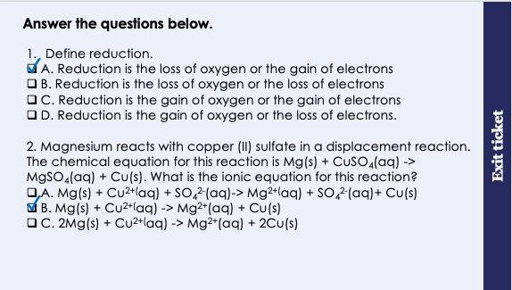
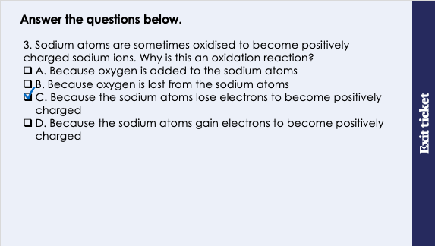
This is the fix-it portion of the lesson
The fix-it is an opportunity to respond to gaps in knowledge, especially those identified by the previous lesson’s exit ticket.
The teacher should customise this slide as needed, to facilitate
reteach, explanation, demonstration or modelling of ideas and concepts that students have not yet grasped or have misunderstood.
practise answering specific questions or of key skills.
redrafting or improving previous work.
Notes:
Fix-it guidance from previous exit ticket:
Q1. Answer: A
If students answer B or D, they think that reduction is the loss of electrons. To fix-it, use OIL RIG to help students remember that oxidation is the loss of electrons and reduction is the gain of electrons.
If students answer C, they think that reduction is the gain of oxygen. They might be mis-using the OIL RIG (thinking it refers to reduction as gaining oxygen instead of reduction gaining electrons). To fix-it, remind students that the word oxidation starts with ‘ox’ because it involves the gain of oxygen.
Q2. Answer: B
If students answer A, they have successfully written each part of the chemical equation as ions, however they have forgotten to remove the species that appear on both sides of the equation (in this case the sulfate ion). To fix-it, remind students that any species that appears in exactly the same way on both sides of the equation is not included in the final ionic equation. Give students more practice in writing ionic equations.
If students answer C, they have included the correct species in their ionic equation, however they have made the common error of trying to balance this equation. Students sometimes mistakenly treat the ion charges as if they were subscript numbers or coefficients. To fix-it, remind students that the charges are not indicative of the number of ions. Give students more practice in writing ionic equations.
Q3. Answer: C
If students answer A, they are taking the term oxidation in this case to mean the addition of oxygen, and have not considered (or do not know) what oxidation means in term of electrons. To fix-it, remind students that where oxidation results in ions becoming charged, that the question is referring to the loss of electrons (and not the gain of oxygen).
If students answer B, they are taking the term oxidation in this case to mean the removal of oxygen. This means they both do not understand that oxidation is the addition of oxygen, and they have not considered that this question requires a consideration of oxidation in terms of electrons. To fix-it, remind students of the definition of oxidation in terms of oxygen, and in terms of electrons. Remind students that where oxidation results in ions becoming charged, that the question is referring to the loss of electrons.
If students answer D, they correctly recognise that the question is referring to oxidation in terms of electrons (and not in terms of the gain or loss of oxygen). However, the student thinks that gaining electrons results in a positive charge. To fix-it, remind students that electrons have a negative charge. Therefore, the gain of electrons will result in negatively charged ions.

Slide 8
What does an ionic equation show?
Mg_{(s)}
+ Cu²⁺_{(aq)}
→
Mg²⁺_{(aq)}
+ Cu_{(s)}
Magnesium atoms lose 2 electrons to become positively charged ions
This loss of electrons is called oxidation
Oxidation is the loss of electrons
Copper ions gain 2 electrons to become neutral atoms
This gain of electrons is called reduction
Reduction is the gain of electrons
A redox reaction is one in which oxidation and reduction take place at the same time
Notes:
Exposition type: Explanation
This is a recap of key information from the previous lesson, which is essential for students to be able to access this lesson’s content.
Model teacher exposition:
Ionic equations actually tell us quite a bit about what happens in a reaction.
Look at the same element on each side of the arrow (on each side of the equation), and think about what has changed.
Let’s take Magnesium.
It’s starts out as a neutral magnesium atom. At the end, it’s a positively charged ion.
So what has happened to magnesium in this reaction? It has lost electrons.
When something loses electrons we can call this oxidation. You have already come across this word before but we had a different definition for it.
Can you remember the other definition of oxidation? Oxidation is the gain of oxygen.
So you see we have two definitions for oxidation, and we will use both these at different times. The definition we have introduced today, that oxidation is the loss of electrons, is the one we always use when talking about ionic equations. You might be asked to define oxidation ‘in terms of electrons’, and then you will know that this is the definition you need.
Now let’s look at copper.
It starts out as a positive copper ion, and by the end of the reaction it is a neutral copper atom.
So what has happened to copper in this reaction? It has gained electrons.
When something gains electrons we can call this reduction. You have already come across this word too, but we had a different definition for it.
Can you remember the other definition of reduction? Reduction is the loss of oxygen.
Just like oxidation we have 2 different definitions for reduction.
To help you remember, we can use the pneumonic OIL RIG, which stands for Oxidation Is Loss (of electrons), Reduction Is Gain (of electrons).
You may want to return to slide 8 and ask students to state whether each row in the table is an example of oxidation or reduction.

Slide 9
Half Equations
We can separate an ionic equation into two half equations.
Mg_{(s)}
+ Cu²⁺_{(aq)}
→
Mg²⁺_{(aq)}
+ Cu_{(s)}
Steps for writing half equations:
Pick one element that’s on both sides of the equation
Write down reactant → product, copying from the equation exactly
Balance the atoms and ions
Add up the charges on both sides
Balance the charges with electrons
1. Magnesium
1. Copper
2. Mg_{(s)} → Mg²⁺_{(aq)}
2. Cu²⁺_{(aq)} → Cu_{(s)}
3. Mg_{(s)} → Mg²⁺_{(aq)}
_{1 atom 1 ion}
3. Cu²⁺_{(aq)} → Cu_{(s)}
_{1 ion 1 atom}
4. Mg_{(s)} → Mg²⁺_{(aq)}
_{Charge: 0 Charge: 2+}
4. Cu²⁺_{(aq)} → Cu_{(s)}
_{Charge: 2+ Charge: 0}
5. Mg_{(s)} → Mg²⁺_{(aq)} + 2e⁻
_{Charge: 0 Charge: 0}
5. Cu²⁺_{(aq)} + 2e⁻ → Cu_{(s)}
Charge: 0 Charge: 0
Notes:
Model teacher exposition:
You can think of half equations as two halves of an ionic equation. We will simple be splitting it up, and each half equation will focus on one kind of element.
Let’s look at the steps for writing half equations.
We start with an ionic equation.
First we choose which element we want to write the half equation for. We will start with magnesium.
Go through the steps on the slide one by one.
Teacher guidance
Be careful that students don’t confuse the charge on an ion with the number of ions – a common misconception. Numbers of atoms/ions will be denoted by a coefficient in front of the species on a subscript number (as in Cl₂ for example), not by superscript ions.

Slide 10
What does a half equation tell us?
Mg_{(s)}
→
Mg²⁺_{(aq)}
+ 2e⁻
Magnesium atoms lose 2 electrons to become positively charged ions
This loss of electrons is called oxidation
Oxidation is the loss of electrons
Cu²⁺_{(aq)} + 2e⁻
→
Cu_{(s)}
Copper ions gain 2 electrons to become neutral atoms
This gain of electrons is called reduction
Reduction is the gain of electrons
Notes:
Exposition type: Explanation
Model teacher exposition:
Half equations actually tell us quite a bit about what happens in a reaction. They give us the same information as an ionic equation, but it’s a little easier to read.
Let’s take Magnesium.
It’s starts out as a neutral magnesium atom. At the end, it’s a positively charged ion.
So what has happened to magnesium in this reaction? It has lost electrons.
When something loses electrons we can call this oxidation. You have already come across this word before but we had a different definition for it.
Can you remember the other definition of oxidation? Oxidation is the gain of oxygen.
So you see we have two definitions for oxidation, and we will use both these at different times. The definition we have introduced today, that oxidation is the loss of electrons, is the one we always use when talking about ionic equations. You might be asked to define oxidation ‘in terms of electrons’, and then you will know that this is the definition you need.
Now let’s look at copper.
It starts out as a positive copper ion, and by the end of the reaction it is a neutral copper atom.
So what has happened to copper in this reaction? It has gained electrons.
When something gains electrons we can call this reduction. You have already come across this word too, but we had a different definition for it.
Can you remember the other definition of reduction? Reduction is the loss of oxygen.
Just like oxidation we have 2 different definitions for reduction.
To help you remember, we can use the pneumonic OIL RIG, which stands for Oxidation Is Loss (of electrons), Reduction Is Gain (of electrons).

Slide 11

Is this correct?
Cl₂ + e⁻ → 2Cl⁻
Notes:
There should be two electrons.
The half equation should be written as:
Cl₂ + 2e⁻ → 2Cl⁻
Suggested guidance:
Talk tasks can be used in a variety of ways to suit the particular needs of the students you are teaching. Through exchanging views with others, students develop their understanding of the science beyond what could be achieved individually.
Science classrooms that successfully integrate talk have the following features:
Science talk is a regular feature of lessons and is woven into classroom activities.
Students are paired or grouped strategically by the teacher to ensure productive interaction. This might take into consideration the students’ proficiency of the English language, how encouraging they might be to peers and their attainment in the topic. It’s a good idea to consider these pairings in the class seating plan.
Students are encouraged and supported to talk, but are not forced to talk.
The teacher should take on the role of a facilitator, engaging with conversations where necessary and encouraging or steering the conversation where needed.
Students are encouraged to use the language they have to express their ideas (e.g., everyday language, imperfect English, native language), but also to incorporate science specific terminology where this is more accurate or has been taught.
6. Scientifically inaccurate ideas are not dismissed by the partner or teacher; open discussion and further investigation are relied on to help students construct ideas that support them to progress in their scientific understanding.
7. Guidelines for behaviour during talk tasks are explicit and frequently reviewed. Rules for students might be:
Listen carefully to your partner
Take turns talking.
Speak one at a time, without interrupting.
Politely agree or disagree and explain why.
Politely point out if your partner has used a scientific word incorrectly, if they have explained the science incorrectly, or if there is a more accurate way to describe something.
If confused, ask questions.
Stay focused on the discussion topic.
Respond to one another.

Slide 12
Drill
What happens to metal atoms in order for them to form ions?
What happens to Group 6 elements in order for them to form ions?
How many electrons will a beryllium atom lose in order to form an ion?
What is the charge on a chloride ion
Write down the formula for a nitrate ion
Write a half equation that shows the following: a lithium atom loses one electron to become a lithium ion with the formula Li⁺
Write a half equation that shows the following: a fluoride ion with the formula F⁻ loses an electron to form a fluorine atom.
Rewrite the following half equation, adding in the state symbols: Na⁺ + e⁻ → Na
For the half equation in question 8, state whether sodium ion is oxidised or reduced.
Explain your answer to question 9.
Notes:
Purpose: This is a knowledge drill. The purpose of this is to check that the critical knowledge is secure before pupils move onto independent practice.
Suggested guidance: There are a range of ways this could be done depending on time and ability range of the class:
Mini whiteboards
As full sentences in exercise books
As short answers in exercise books
In the pupil workbook
As pair talk
As cold call

Slide 13
Drill answers
Metal atoms lose electrons to form ions
Group 6 elements gain 2 electrons to form ions
A beryllium atom will lose 2 electrons to form an ion
A chloride ion has the formula Cl⁻, so it has a -1 charge
A nitrate ion has the formula NO₃⁻
Li_{(s)} → Li⁺_{(aq)} + e⁻
F⁻_{(aq)} + e⁻ → F_{(s)}
Na⁺_{(aq)} + e⁻ → Na_{(s)}
The sodium ion is reduced
The sodium ion is reduced because it gains electrons to form a sodium atom
Notes:
Purpose: This is a knowledge drill. The purpose of this is to check that the critical knowledge is secure before pupils move onto independent practice.
Suggested guidance: There are a range of ways this could be done depending on time and ability range of the class:
Mini whiteboards
As full sentences in exercise books
As short answers in exercise books
In the pupil workbook
As pair talk
As cold call

Slide 14
I: Writing half equations
The ionic equation for a reaction is as follows:
Use this ionic equation to write two half equations.
Fe_{(s)} + Cu²⁺_{(aq)} + SO₄²⁻_{(aq)} → Fe²⁺_{(aq)} + SO₄²⁻_{(aq)} + Cu_{(s)}
Steps for writing half equations:
Pick one element that’s on both sides of the equation
Write down reactant → product, copying from the equation exactly
Balance the atoms and ions
Add up the charges on both sides
Balance the charges with electrons
Fe_{(s)} + Cu²⁺_{(aq)} → Fe²⁺_{(aq)} + Cu_{(s)}
1. Iron
1. Copper
2. Fe_{(s)} → Fe²⁺_{(aq)}
2. Cu²⁺_{(aq)} → Cu_{(s)}
3. Fe_{(s)} → Fe²⁺_{(aq)}
_{1 atom 1 ion}
3. Cu²⁺_{(aq)} → Cu_{(s)}
_{1 ion 1 atom}
4. Fe_{(s)} → Fe²⁺_{(aq)}
_{Charge: 0 Charge: 2+}
4. Cu²⁺_{(aq)} → Cu_{(s)}
_{Charge: 2+ Charge: 0}
5. Fe_{(s)} → Fe²⁺_{(aq)} + 2e⁻
_{Charge: 0 Charge: 0}
5. Cu²⁺_{(aq)} + 2e⁻ → Cu_{(s)}
Charge: 0 Charge: 0
Notes:
Purpose: The I-We-You section aims to support pupils to build skills that they most commonly need when answering questions associated with this knowledge in the assessment. This section is also used to interleave other content we expect pupils to know at this stage of their education in order that they build a big picture of the science they are learning.
For the ‘I’ activity, the teacher should model how to answer the question. They can do this by narrating their thinking process aloud, and making links to learning earlier in the lesson explicit.
For the ‘we’ activity, the teacher and students work though a similar example together, in order to prepare students to be able to answer a similar question independently.
Opportunities for the ‘you’ activity – independent practise – occur in the activity portion of the lesson once the student is secure enough to process independently.

Slide 15
We: Writing half equations
The ionic equation for a reaction is as follows:
Use this ionic equation to write two half equations.
Br_{2(s)} + 2Na⁺_{(aq)} + 2I⁻_{(aq)} → 2Na⁺_{(aq)} + 2Br⁻_{(aq)} + I_{2(s)}
Steps for writing half equations:
Pick one element that’s on both sides of the equation
Write down reactant → product, copying from the equation exactly
Balance the atoms and ions
Add up the charges on both sides
Balance the charges with electrons
Br_{2(s)} + 2I⁻_{(aq)} → 2Br⁻_{(aq)} + I_{2(s)}
1. Bromine
1. Iodine
2. Br_{2(s)} → 2Br⁻_{(aq)}
2. 2I⁻_{(aq)} → I₂ _{(s)}
3. Br_{2 (s)} → 2Br⁻_{(aq)}
_{2 atoms 2 ions}
3. 2I⁻ _{(aq)} → I₂ _{(s)}
2 ions 2 atoms
4. Br_{2 (s)} → 2Br⁻ _{aq)}
_{Charge: 0 Charge: -2}
4. 2I⁻ _{(aq)} → I₂ _{(s)}
_{Charge: -2 Charge: 0}
5. Br_{2 (s)} + 2e⁻ → 2Br⁻_{(aq)}
_{Charge: -2 Charge: -2}
5. 2I⁻ _{(aq)} → I_{2(s)} + 2e⁻
Charge: -2 Charge: -2
Notes:
Purpose: The I-We-You section aims to support pupils to build skills that they most commonly need when answering questions associated with this knowledge in the assessment. This section is also used to interleave other content we expect pupils to know at this stage of their education in order that they build a big picture of the science they are learning.
For the ‘I’ activity, the teacher should model how to answer the question. They can do this by narrating their thinking process aloud, and making links to learning earlier in the lesson explicit.
For the ‘we’ activity, the teacher and students work though a similar example together, in order to prepare students to be able to answer a similar question independently.
Opportunities for the ‘you’ activity – independent practise – occur in the activity portion of the lesson once the student is secure enough to process independently.

Slide 16
You: Writing half equations
The ionic equation for a reaction is as follows:
Use this ionic equation to write two half equations.
Cl_{2(aq)} + 2K⁺_{(aq)} + 2Br⁻_{(aq)} → 2K⁺_{(aq)} + 2Cl⁻_{(aq)} + Br_{2(aq)}
Steps for writing half equations:
Pick one element that’s on both sides of the equation
Write down reactant → product, copying from the equation exactly
Balance the atoms and ions
Add up the charges on both sides
Balance the charges with electrons
Cl_{2(aq)} + 2Br⁻_{(aq)} → 2Cl⁻_{(aq)} + Br_{2(aq)}
1. Bromine
1. Chlorine
2. 2Br⁻_{(aq)} → Br_{2(aq)}
2. Cl_{2(aq)} → 2Cl⁻_{(aq)}
3. 2Br⁻_{(aq)} → Br_{2(aq)}
2 ions 2 atoms
3. Cl_{2(aq)} → 2Cl⁻_{(aq)}
2 atoms 2 ions
4. 2Br⁻_{(aq)} → Br_{2(aq)}
_{Charge: -2 Charge: 0}
4. Cl_{2(aq)} → 2Cl⁻_{(aq)}
_{Charge: 0 Charge: -2}
5. 2Br⁻_{(aq)} → Br_{2(aq)} + 2e⁻
_{Charge: -2 Charge: -2}
5. Cl_{2(aq)} + 2e⁻ → 2Cl⁻_{(aq)}
Charge: -2 Charge: -2
Notes:
Purpose: The I-We-You section aims to support pupils to build skills that they most commonly need when answering questions associated with this knowledge in the assessment. This section is also used to interleave other content we expect pupils to know at this stage of their education in order that they build a big picture of the science they are learning.
For the ‘I’ activity, the teacher should model how to answer the question. They can do this by narrating their thinking process aloud, and making links to learning earlier in the lesson explicit.
For the ‘we’ activity, the teacher and students work though a similar example together, in order to prepare students to be able to answer a similar question independently.
Opportunities for the ‘you’ activity – independent practise – occur in the activity portion of the lesson once the student is secure enough to process independently.

Slide 17
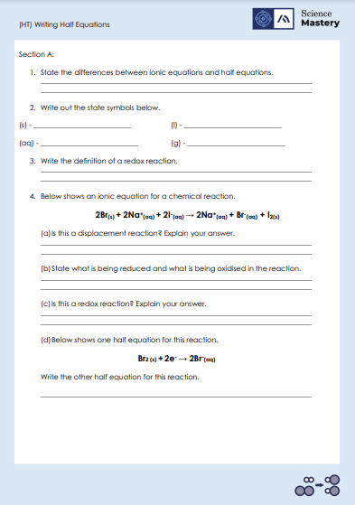
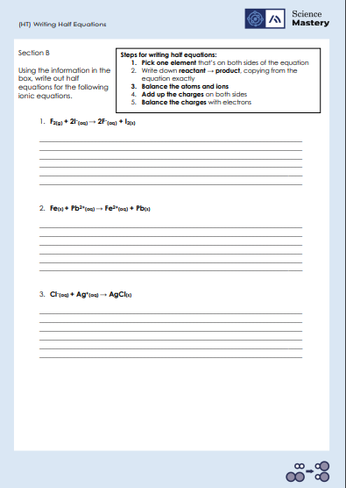
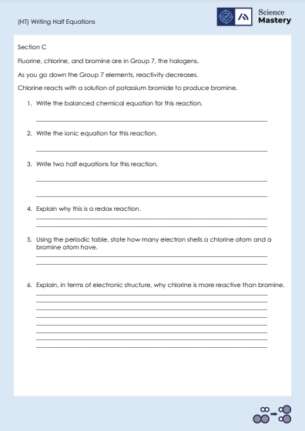
Activity

Slide 18
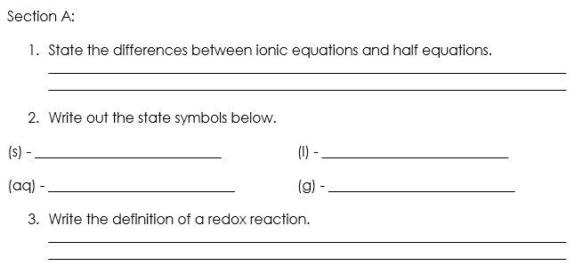
Answers – Section A
Half equations include electrons whereas ionic equations don’t.
An ionic equation is split into half equations
solid
liquid
aqueous / solution
gas
A reaction in which oxidation and reduction take place at the same time​

Slide 19
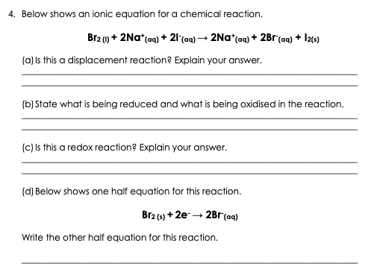
Answers – Section A
Yes, bromine is more reactive than iodine, so it displaces it
Bromine atoms are being reduced.
Iodine ions are being oxidised.
Yes, because both reduction and oxidation are happening in the reaction.
2I⁻ _{(aq)} → I_{2(s)} + 2e⁻

Slide 20
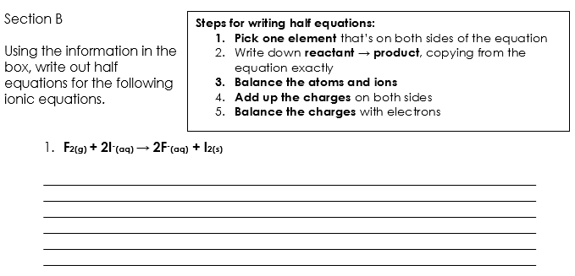
Answers – Section B
fluorine
iodine
F_{2(g)} → 2F⁻_{(aq)}
2I⁻_{(aq)} → I₂ _{(s)}
2 atoms → 2 ions
2 ions → 2 atoms
charge: 0 → charge: -2
charge: -2 → charge: 0
Br_{2 (s)} + 2e⁻ → 2Br⁻_{(aq)}
2I⁻ _{(aq)} → I_{2(s)} + 2e⁻
charge: -2 → charge: -2
charge: -2 → charge: -2

Slide 21
Answers – Section B
iron
lead
Fe_{(s)} → Fe²⁺_{(aq)}
Pb²⁺_{(aq)} → Pb_{(s)}
1 atom → 1 ion
1 ion → 1 atom
charge: 0 → charge: +2
charge: +2 → charge: 0
Fe _{(s)} → Fe²⁺_{(aq)} + 2e⁻
Pb²⁺_{(aq)} + 2e⁻ → Pb_{(s)}
charge: 0 → charge: 0
charge: 0 → charge: 0

Slide 22
Answers – Section B
chlorine
silver
Cl⁻ _{(aq)} → Cl _{(s)}
Ag⁺_{(aq)} → Ag _{(s)}
1 ion → 1 atom
1 ion → 1 atom
charge: -1 → charge: 0
charge: +1→ charge: 0
Cl⁻ _{(aq)} → Cl_{(s)} + e⁻
Ag⁺_{(aq)} + e⁻ → Ag _{(s)}
charge: -1 → charge: -1
charge: 0 → charge: 0

Slide 23
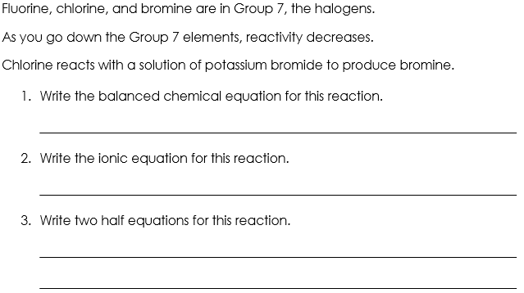
Answers – Section C
Cl₂ + 2KBr → 2KCl + Br₂
Cl_{2(g)} + 2Br⁻_{(aq)} → 2Cl⁻_{(aq)} + Br_{2 (l)}
Cl_{2 (g)} + 2e⁻ → 2Cl⁻_{(aq)}
2Br⁻_{(aq)} → Br_{2 (l)} + 2e⁻

Slide 24
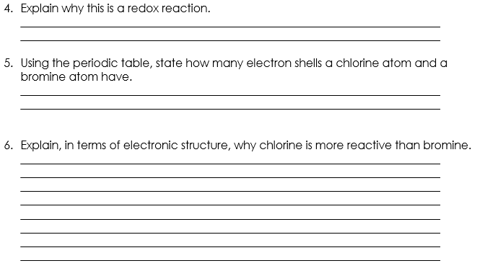
Answers – Section C
Both reduction and oxidation reactions are happening in the reaction.
Chlorine is in period 3 so it has 3 electron shells.
Bromine is in period 4 so it has 4 electron shells.
Chlorine is a smaller than bromine because it has 3 electron shells whereas bromine has 4 electron shells.
This means that chlorine has a shorter distance between the positively charged nucleus and the outer shell.
Therefore chlorine has less shielding of the nucleus than bromine,
so can gain one electron more easily which makes it more reactive.

Slide 25
Answer the questions below.
The reaction between magnesium and copper (II) sulfate can be represented by the following ionic equation:
Mg_{(s)} + Cu²⁺_{(aq)} → Mg²⁺_{(aq)} + Cu_{(s)}
Which answer correctly splits this ionic equation into two half equations?
A. Mg_{(s)} → Mg²⁺_{(aq)} + 2e⁻ Cu²⁺_{(aq)} + 2e⁻ → Cu_{(s)}
B. Mg_{(s)} + 2e⁻ → Mg²⁺_{(aq)} Cu²⁺_{(aq)} → Cu_{(s)} + 2e⁻
C. Mg_{(s)} → Mg²⁺_{(aq)} Cu²⁺_{(aq)} → Cu_{(s)}
✓
2. What is a redox reaction?
A. A redox reaction is one which oxidation or reduction take place
B. A redox reaction is one in which oxidation and reduction take place
C. A redox reaction is one in which oxidation and reduction take place at the same time
✓
Notes:
Q1. Answer: A
If students answer B, they are adding the electrons to the wring side of their half equations. To fix-it, take one side of the incorrect answer they have chosen here, for example ‘Mg + 2e’, ask students what charge magnesium would have if we added 2 electrons. The answer is negative, so this doesn’t make sense! Give students some more ionic equations to practise splitting up into ionic equations.
If students answer C, they have successful chosen the correct species to put into each of the half equations, however they have forgotten to represent the electrons. To fix-it, model the method for writing a half equation using a full ionic equation, and then give students some more ionic equations to practise splitting up into half equations.
Q2. Answer: C
If students answer A or B, students have selected a definition which is either incorrect or not specific enough to be correct. To fix-it, use an example of a redox reaction equation to show where oxidation and reduction are happening simultaneously to define a redox reaction. Ask students to repeat this definition from memory.

Slide 26
Answer the question below.
3. Complete the half equation to show the oxidation of a potassium atom.
K_{(s)} →
A. K²⁺_{(aq)} + 2e⁻
B. K⁺_{(s)} + e⁻
C. K⁺_{(aq)} + e⁻
✓
Notes:
Q3. Answer: C
If students answer A, they have chosen the wrong number of electrons to oxidise a potassium ion. To fix-it, point out that potassium is in group 1 of the Periodic Table, and therefore it has 1 electron on its valence shell to lose readily. This means that potassium forms ions with a +1 charge, not +2. You can also reference the table of ionic formulae in the knowledge organiser.
If students answer B, they have deduced the correct ion formula for potassium, and have represented this correctly with 1 electron, however they have incorrectly written the state symbol as (s) for the potassium ion. To fix-it, remind students that ions appear in an aqueous state. Ask students to practice adding in the state symbols for a series of ionic and half equations.

Slide 27
Lesson C4.2.5
What was good about this lesson? | What can we do to improve this lesson?
Send us your feedback by clicking this link
or by emailing sciencemastery@arkonline.org
Thank you!

